Slide 1
Combination of Classifiers for Indoor Room Recognition CGS participation at ImageCLEF2010 Robot Vision Task
Walter Lucetti
Emanuel Luchetti
Gustavo Stefanini
Advanced Robotics Research Center Scuola Superiore di Studi e Perfezionamento Sant’Anna
w.lucetti@sssup.it e.luchetti@sssup.it

Slide 2
Abstract.
This paper represents a description of our approach to the problem of topological localization of a mobile robot using visual information.
Our method has been developed for ImageCLEF 2010 Robot Vision Task challenge.
The challenge was focused on the problem of visual place classification, with a special focus on generalization.
The goal was to recognize rooms by the images captured with a stereo camera mounted on a mobile robot within an office environment.
Algorithms should be able to reply to question “Where are you?”, saying “I don’t know” if the room analyzed was not presented during training phase.

Slide 3
Abstract.
For the challenge three sequences were given: Training Set, Validation Set and Test Set acquired on three different floors of the same building.
We chose to approach the challenge realizing a multi-Level machine learning architecture, made of a first “weak” classifiers
Level based on visual features extracted from images and of a second Level performing fusion of first Level outputs.
We developed four configurations to determine the best approach to problem solving:
  Committees of Experts,
  Stacked Regression with Support Vector Machines stage,
  Stacked Regression with Artificial Neural Network stage,
  Weighted Linear Combination of all the three previous methods.
Finally the result of twenty RUNs, five RUNs for each of the four different system configurations, were submitted at ImageCLEF challenge.

Slide 4
Concepts:
ImageCLEF - image processing conference with competition
Visual Place Classification – method to ….,
Features Extraction …. to select
Support Vector Machines …. to select
Bayes Classifier…. to select
Artificial Neural Network…. Software realization of NN idea
Committees of Experts…. to select
Stacked Regression…. to select
Stacked Generalization…. to select
Stereo Vision…. Two cameras used for image acquisition
Hough Transform …. to transform image to the set of line equations
Discrete Fourier Transform…. Butterfly variant works on Complex numbers

Slide 5
1 Introduction
ImageCLEF1 hosted in 2010 the third edition of Robot Vision Challenge.
  ImageCLEF: http://www.imageclef.org
The task addressed the problem of Visual Place Classification, this edition with a special focus on generalization [1].
  [1] Andrzej Pronobis, Marco Fornoni, Henrik I. Christensen, and Barbara Caputo, “The Robot Vision Task at ImageCLEF 2010” In the Working Notes of CLEF 2010, Padova, Italy, 2010.
We chose to approach the challenge using Classifiers Combination method [2], after the analysis of the provided training set images.
  [2] Dima, C. S., Nicolas, V., & Martial, H., “Classifier Fusion for Outdoor Obstacle Detection”, In International Conference on Robotics and Automation - Vol. 1, pp. 665-671, 2004.

Slide 6
1. Introduction
Together to Training Set a Validation Set was released.
Validation Set consisted of 2069 image couples acquired on a different floor of the same building used to create the training set, but only seven known rooms was visited and three “Unknown” rooms were added to be able to test “Unknown” recognition techniques

Slide 7
Training sets
Finally after about one month from Training Set release, a final Test Set was released.
It consisted of 2741 unlabeled image couples acquired to a third floor of the same building.
Analogue rooms were visited and other “Unknown” rooms were presented.
We performed twenty different RUNs on test set:
  five RUNs for each of the four different Classifiers Combination methods we developed.
For each submitted RUN was given a score as described in [1].

Slide 8
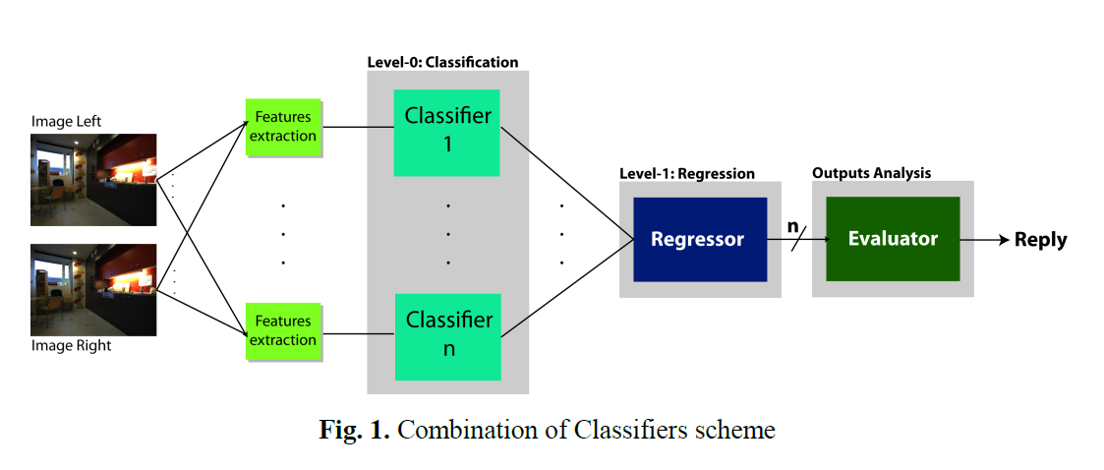
2. The idea of the architecture : Combination of classifiers in robot vision
The approach we chose to follow is illustrated in Fig. 1:
  each stereo image couple is processed to extract different kind of visual features that are analyzed by a first stage of classifier (Level-0) to produce a set of label.

Slide 9
System Architecture based on levels
Level-0. The set of label produced by Level-0 becomes the input for the second stage, Level-1.
Level-1 produces a set of values indicating the Confidence Level of every possible output class.
A final stage analyzes Level-1 outputs and gives in output the final reply.

Slide 10
Motivation for this type of architecture
Many method of Image Classification using machine learning techniques were implemented using a single type of features extracted from single image or Stereo Images couple.
The classification made on one type of features works well only on a well stated kind of environment
  (i.e. texture features extraction is right for highly repetitive images, but is not informative for homogeneous images).
Combining different kind of Level-0 classifiers allows to choose the classifier that gives the correct reply according to the image presented as input at the system.
Level-1 is capable of taking several classifier outputs as input and to learn from training data how well they perform and how their outputs should be combined.
Final results confirmed the strength of the method (Par. 7).

Slide 11
3 Level-0: a Pool of Experts
The Level-0 stage that we realized is composed of a total of ten classifiers, five set of two kind of classifiers working in couple:
  Support Vector Machines [10]
  and Normal Bayes Classifier [11].
  [10] J. Shawe-Taylor, N. Cristianini, “Support Vector Machines and other kernel-based learning methods”- Cambridge University Press, 2000.
  [11] K. Fukunaga. “Introduction to Statistical Pattern Recognition. second ed.”, New York: Academic Press, 1990.

Slide 12
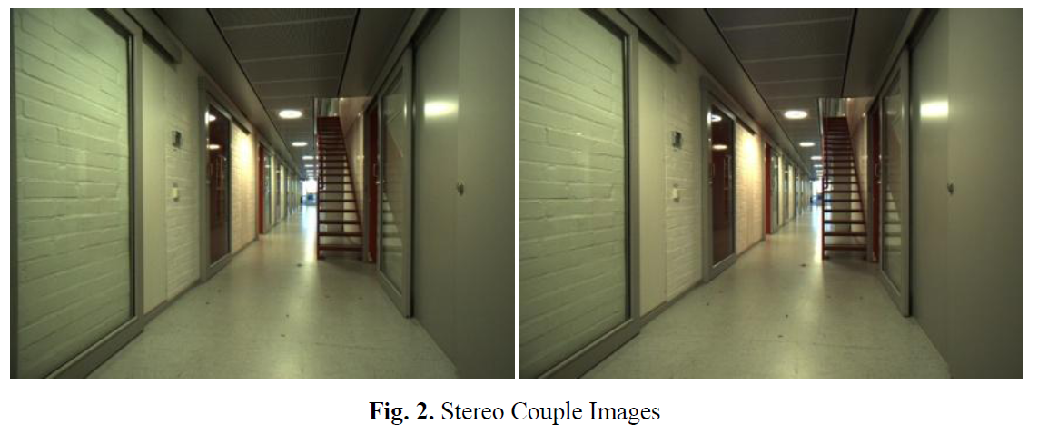
Five different sets of visual features are extracted from every pair of stereo image (Fig. 2) of the dataset:
  Color Features
  Texture Features
  Segment Features
  Depth Features
  3D Space Features
Every couple of classifiers is trained on the same set of visual features such to obtain two different replies of the same type, such to increase the probability of obtaining a correct classification.

Slide 13
Various Features

Slide 14
3.1. Color Features

Slide 15
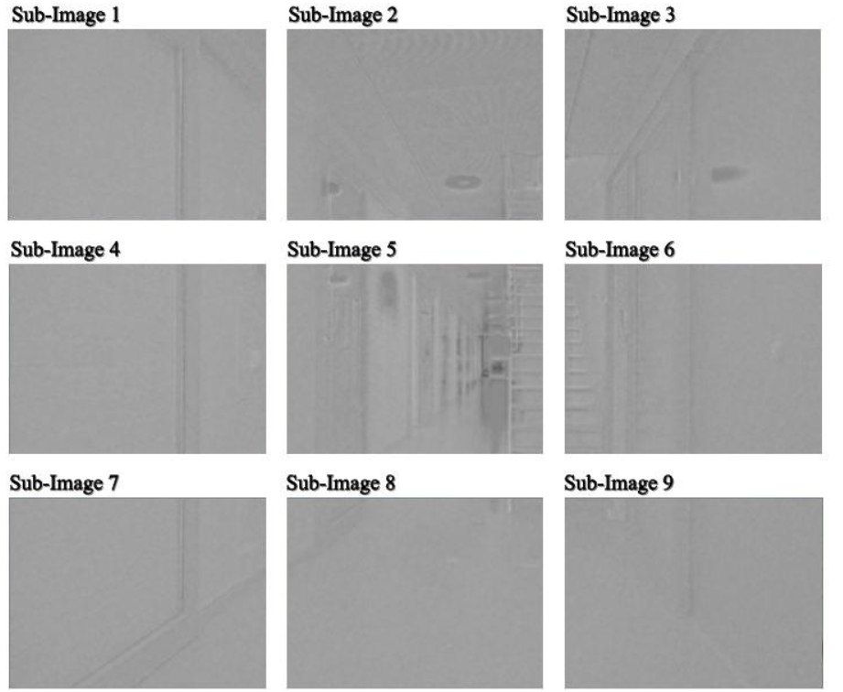
Fig. 3. Color feature extraction
Left image of every frame stereo couple is converted from RGB to Luv color mode (Fig. 3) and divided in nine sub-image.
From every sub-image are extracted mean and standard deviation of each of the three image channels for a total of 54 features.

Slide 16
3.2. Texture Features

Slide 17
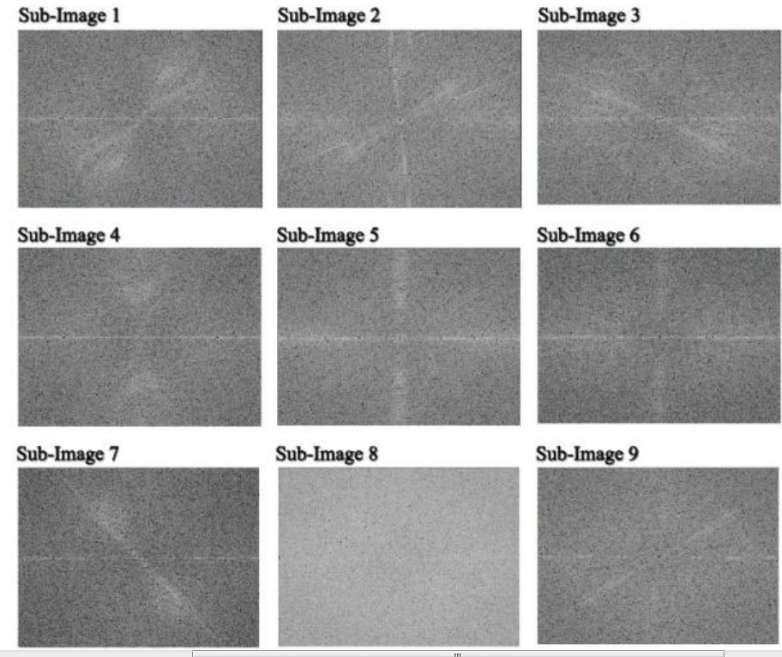
Fig. 4. Texture Features Extraction
Left image of every frame stereo couple is divided in nine sub-image that are processed with Discrete Fourier Transform to extract frequency components (Fig. 4).
Magnitude spectrum of each sub-image is calculated and are extracted frequency and phase of the ten higher power components, for a total of 180 features.

Slide 18
3.3. Segment Features
Left image from every frame is filtered using Canny Edge Detector algorithm [12] and from result image are extracted 30 line segments (Fig. 5) using Probabilistic Hough Transform [8].
  [12] “Canny Edge Detector” - http://en.wikipedia.org/wiki/Canny_edge_detector.
  [8] Matas, J. and Galambos, C. and Kittler, J.V., “Progressive Probabilistic Hough Transform”, BMVC98, 1998.
For every segment are extracted length and angle for a total of 60 features.

Slide 19
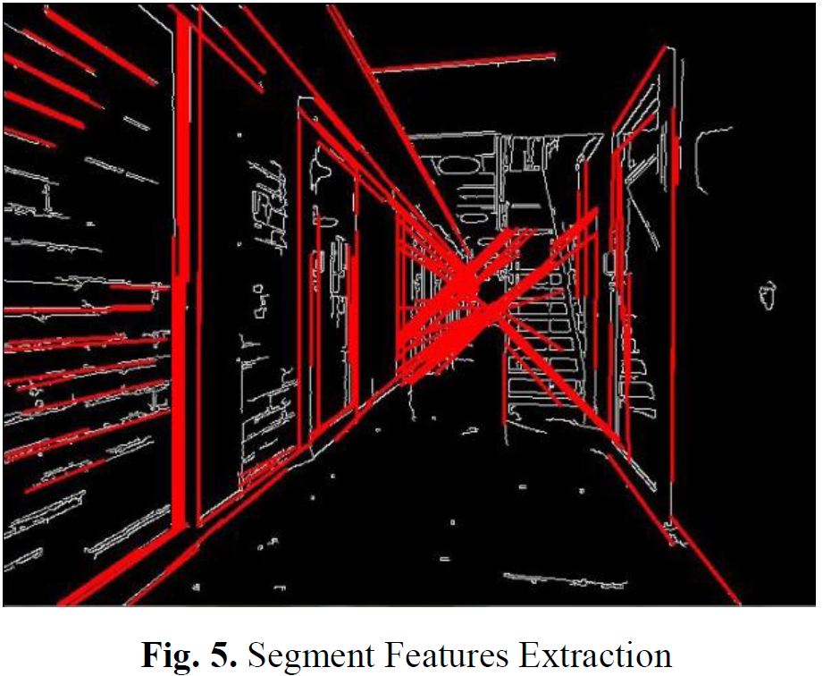
Left image from every frame is filtered using Canny Edge Detector algorithm and from result image are extracted 30 line segments using Probabilistic Hough Transform

Slide 20
3.4. Depth Features
From every frame stereo couple disparity map is calculated (Fig. 6) using Semi-Global Block Matching Stereo Correspondence algorithm [9].
  [9] H. Hirschmuller, “Stereo Vision in Structured Environments by Consistent Semi-Global Matching”, CVPR (2)'06, pp. 2386-2393, 2006.
Disparity map is divided in nine grayscale sub-images, and from each sub-image are extracted mean and standard deviation for a total of 18 features.

Slide 21
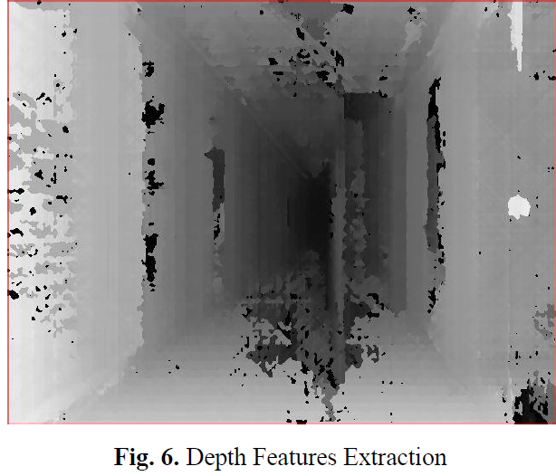
From every frame stereo couple disparity map is calculated (Fig. 6)
using Semi-Global Block Matching Stereo Correspondence algorithm .

Slide 22
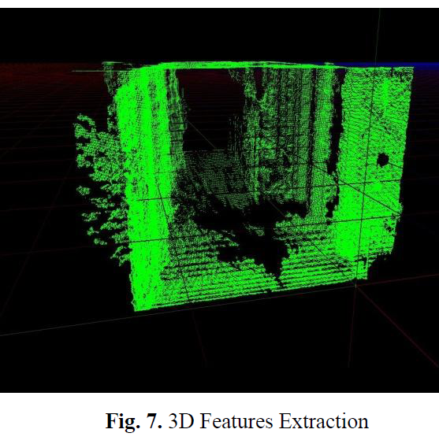
3.5. 3D Space Features
Using stereo system Intrinsic Parameters every pixel of Disparity Map is projected in 3D space coordinates system (Fig. 7).

Slide 23
3D Space Features
From 3D Space Information are extracted seven features:
  mean and standard deviation of distance of each 3D point from robot reference system origin;
  mean and standard deviation of height of every 3D point;
  mean, standard deviation and maximum of depth (Z coordinate) values.

Slide 24
Level-1: Regression Stage

Slide 25
4. Level-1: Regression Stage
Classifiers labels obtained at Level-0 stage are combined to produce a set of Confidence Values.
To choose the best approach we analyzed four different algorithms for Level-1 stage:
  Committee of Experts
  Stacked Regression using Support Vector Machines
  Stacked Regression using Artificial Neural Network
  Linear Weighted Combination of the previous three

Slide 26
The Committee of Experts

Slide 27
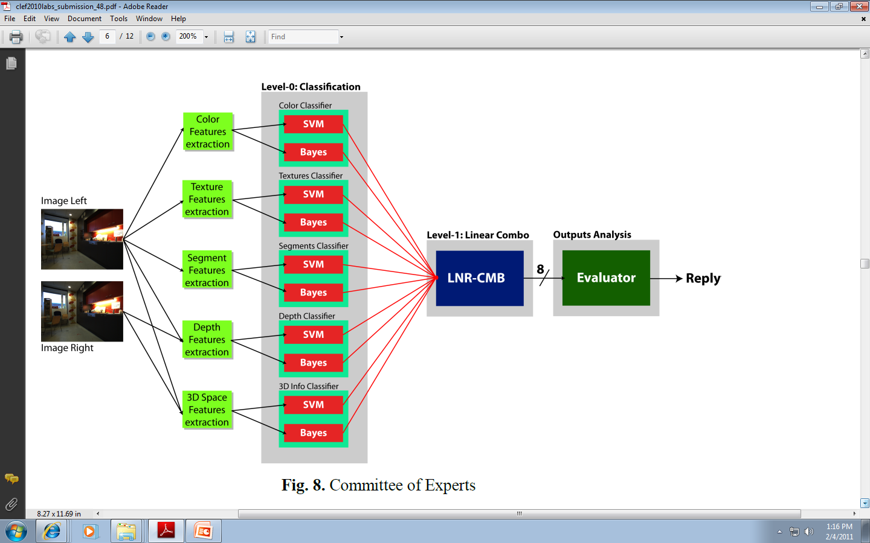
Fig. 8. Committee of Experts
4.1. Committee of Experts

Slide 28
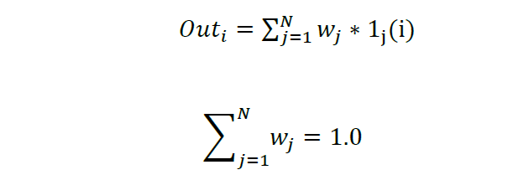
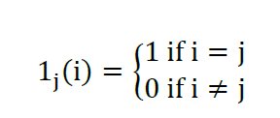
Committee of Experts
COE to improve regression estimates.
Can be used for regression and classification
COE has multiple output values
The algorithm from right estimates a target function h(x) giving N replies 1j(i), with j=1,..N and j = 1,.. M,
Where M is the number of the classes and the Indicator Function is defined as:
.
.
The reply of each j-th Level-0 expert (1_{j}(i)) indicates one (i-th) of the M available classes.
The N outputs coming from Level-0 are linearly combined using weights:
The weights w_{j} are manually assigned to each expert, according to the accuracy evaluated in classifying Validation Set images.

Slide 29
Stacked Regression

Slide 30
4.2. Stacked Regression
Stacked Regression (SR) [6] is based on Stacked Generalization (SG) method, introduced by Wolpert in 1990 [3] and was initially presented as a method to combine multiple models for classification.
  [3] Wolpert, D. H., “Stacked Generalization” Los Alamos, NM, Tech. Rep. LA-UR-90-3460, 1990.
  [6] L. Breiman, “Stacked Regression”, Machine Learning, vol. 24, no. 1, 1996.
  [7] P. Smyth and D. Wolpert, “An evaluation of linearly combining density estimators via stacking”, Information and Computer Science Department, University of California, Irvine, Tech. Rep., 1998.
Next SG was also used for regression and even unsupervised learning [7].

Slide 31
4.2. Stacked Regression
Like in CoE method we have a pool of experts estimating a target function : the pool composes the so called “Level-0 generalizer” and it is trained in the first stage of SR.
The second stage consists in training a Regression Level that:
  takes as inputs the outputs of Level-0 generalizers
  tryis to estimate the Confidence Values of every possible output class.

Slide 32
“Level-1 Regression
This stage is called “Level-1 Regression” and its purpose is to learn the biases of Level-0 generalizers.
It is very important that Level-1 and Level-0 machine learning networks are trained using different dataset:
  in this way generalization capabilities are granted, and over fitting probabilities is decreased.

Slide 33
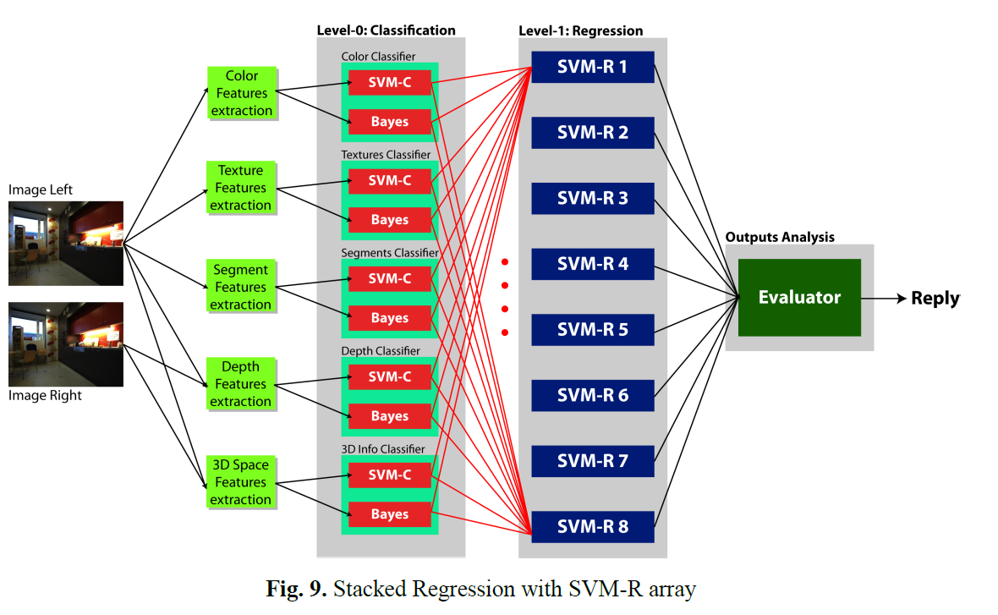
SVM-R array
We chose to evaluate two kinds of Level-1 approach:
  Array of Support Vector Machines Regressors (SVM-R), one for every possible output class (Fig. 9).

Slide 34
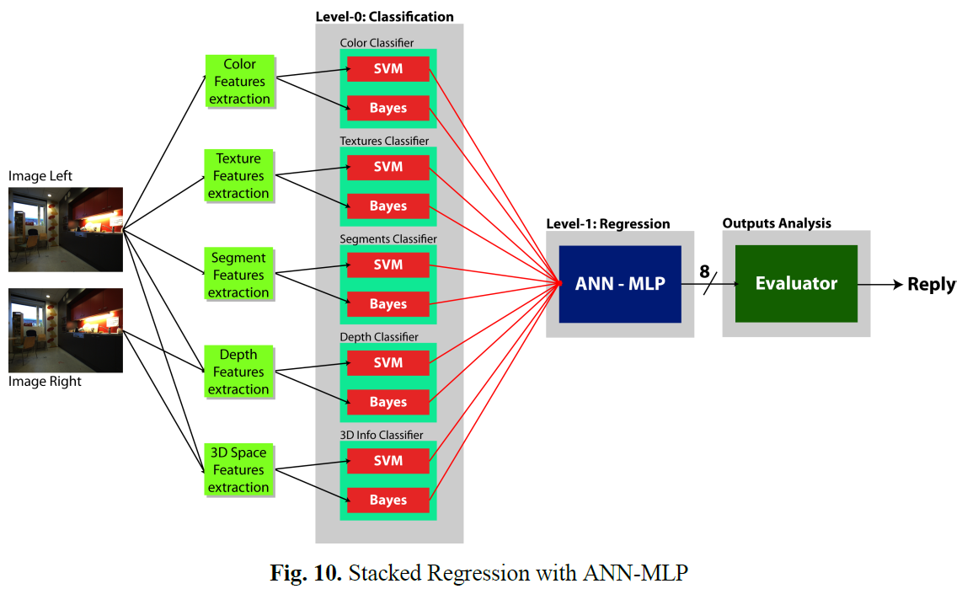
Artificial Neural Network - Multi Layer Perceptron (ANN-MLP) with an output for every possible class (Fig. 10).
SVM-R approach is different from ANN-MLP since every Level-1 output is independent from each other.
Every output is obtained using a different SVM-R network trained to recognized its own class and to regret all the other.
ANN-MLP outputs are instead obtained by a single network with multiple outputs, where each output is influenced by the full connection between units of hidden-outputs layer.

Slide 35
Linear Combination of methods

Slide 36
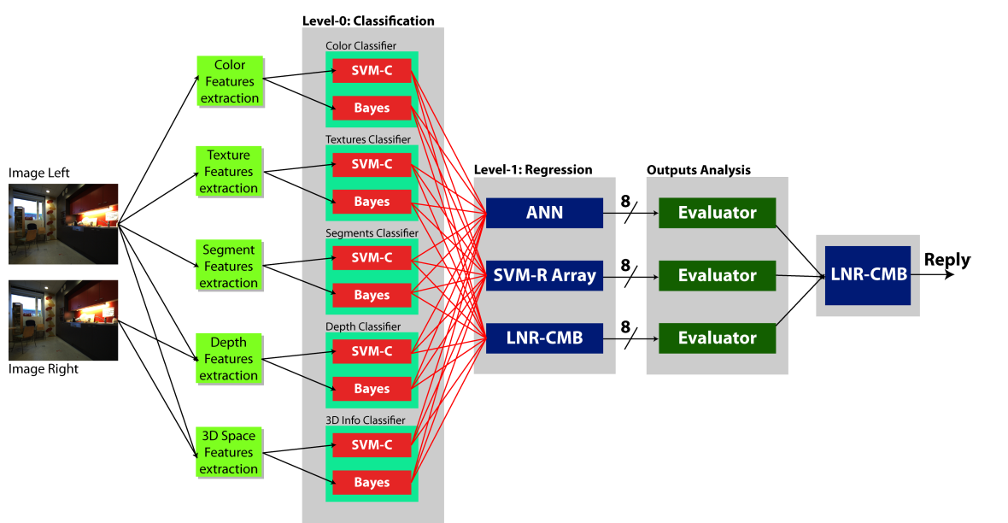
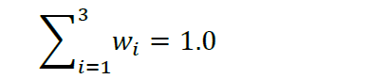
4.3 Linear Combination of methods
Fig 11. Linear Weighted Combination of Regressors
The three methods previously analyzed can be linearly combined using weights such to obtain a unique more precise reply; the combination scheme is illustrated in Fig. 11.
The linear combination is weighted and weights w_{i} have been chosen according to generalization capabilities evaluated during Validation Phase on Validation Set images, where

Slide 37
Final Stage and Training

Slide 38
5. Final stage: Level-1 outputs analysis
For every room class available Level-1 stage gives an output in the range [0.0, 1.0],
  Where:
    0.0 implies total rejection
    1.0 implies total agreement.

Slide 39
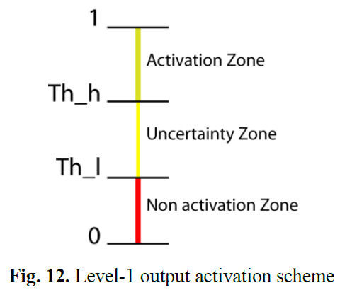
At every available class is assigned a Level of Confidence based on the activation threshold scheme as illustrated in Fig. 12.
Th_h and Th_l values are respectively high and low activation threshold.
If only one output was in Activation Zone the class related to that output has been chosen as final label reply;
  if more than one output or none was in Activation Zone,
    we chose to reply “UNKNOWN”
    or to not reply according to the number of class present in every zone.

Slide 40
6. Training phase
Training phase is a critical step for Machine Learning approach.
A good configuration of training set will bring to a good performance of machine learning system.
Training Set available for Robot Vision task was highly unbalanced.
There were rooms with 1146 examples images and rooms with only 192 images on a total of 4782 examples.

Slide 41
6. Training phase
Using the original training set the following happened:
  a system very well performing on rooms with a large number of example (i.e. Corridor)
  and very weak for the others (i.e. Printer Area).
To avoid this issue, Training Set has been reorganized according to this scheme:
  examples was randomly distributed to avoid “sequenced training”;
  for every class was chosen 600 examples, replicating frames for those classes with less than 600 image couples;
  for SG configurations, examples chosen to be presented to Level-0 stage were not inserted in training set for Level-1;

Slide 42
6. Training phase
With this configuration scheme they obtained a remarkable improvement in performances
  two different training sets for Level-0 and Level-1,
  each composed of 4800 examples (just compare RUN #2 and RUN #10 scores in Table 1).

Slide 43
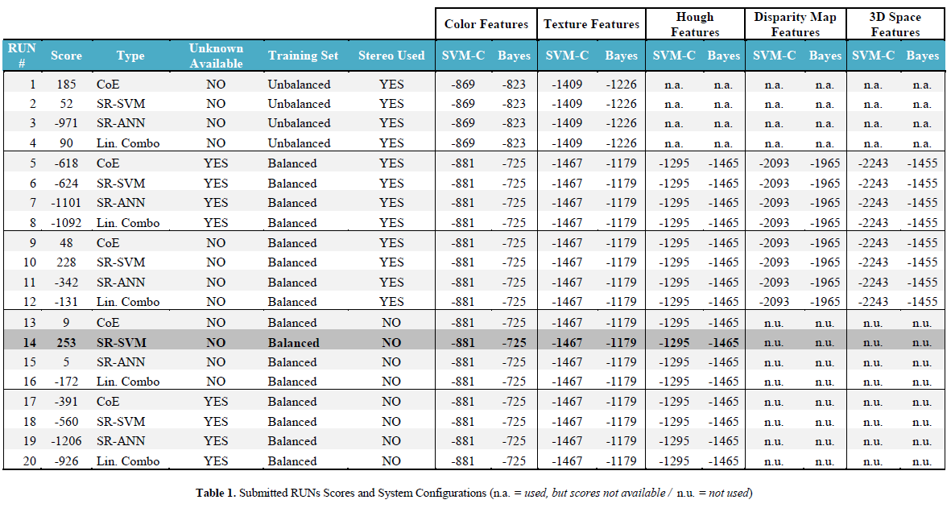
Table 1. Submitted RUNs Scores and System Configurations (n.a. = used, but scores not available / n.u. = not used)

Slide 44
7. Final Results and Future Works
For ImageCLEF 2010 Robot Vision Task twenty RUNs were submitted (Table 1) on a total of 42 RUNs submitted by all the team participating.
Our best score has been 253 (the winner totalized 677), obtained in RUN #14 and we placed 4th.
The twenty submitted RUNs can be subdivided in five groups of four RUNs.
Each group was composed of four tests on all the four methods previously illustrated and was different from the other for at least one feature.
The first group was an initial test made training Level-0 Classifiers and Level-1 Regressors on the original unbalanced Training Set, for the other groups the same Balanced Training Set was used (see Par. 6).

Slide 45
Final Results and Future Works
The second group was the first test carried on recognition of “Unknown Rooms”; “Unknown Rooms” recognition has been disabled in the third group
  where in case of not dominant Level-1 reply we chose to not give a reply label for the analyzed frame.
In the last two groups Level-1 Regressors was trained again on the same Level-0 outputs of second and third groups,
  with Stereo Vision disabled such to determinate its real contribute to final results,
  since we noticed that Disparity Map and 3D Space Classifiers performances were very poor.
Analyzing result table is evident the strength of Combining of Classifiers method.

Slide 46
Final Results and Future Works
Looking at RUNs from #9 to #12 we can notice that the best classifier in Level-0 (columns from 7 to 16) obtained a score of -725, while the worst result (column 2) in Level-1 configurations is -342.
This is evident also looking at RUNs from #13 to #16.

Slide 47
Final Results and Future Works
Our best RUN, the #14, was obtained using SR with SVM approach, choosing to not classify unknown rooms (giving indeed no reply) and deactivating Stereo Vision Features that was not very performing (as highlighted in columns of runs from #5 to #12).
The weakness of our method lies in unknown rooms recognizing phase.
To improve this phase we developed a method that introduces a new Level of classification that, taking “Level-1” outputs as input, would make distinction between “known” and “unknown” rooms in the case that there is not a dominant Level-1 output (Par. 5).
The short time available did not allow us to fully complete this enhancement, that is scheduled to realized for our future works on Image Classification.

Slide 48
Conclusions

Slide 49
References
[1] Andrzej Pronobis, Marco Fornoni, Henrik I. Christensen, and Barbara Caputo, “The Robot Vision Task at ImageCLEF 2010” In the Working Notes of CLEF 2010, Padova, Italy, 2010.
[2] Dima, C. S., Nicolas, V., & Martial, H., “Classifier Fusion for Outdoor Obstacle Detection”, In International Conference on Robotics and Automation - Vol. 1, pp. 665-671, 2004.
[3] Wolpert, D. H., “Stacked Generalization” Los Alamos, NM, Tech. Rep. LA-UR-90-3460, 1990.
[4] M. Perrone, “Improving regression estimation: Averaging methods for variance reduction with extensions to general convex measure optimization”, Ph.D. dissertation, Brown Universitiy, 1993.
[5] M.P. Perrone and L.N. Cooper, “When networks disagree: Ensemble methods for Hybrid Neural Networks” in Neural Network for speech and Image Processing, R. J. Mammone, Ed. Chapmann-Hallpp.126-142, 1993.
[6] L. Breiman, “Stacked Regression”, Machine Learning, vol. 24, no. 1, 1996.
[7] P. Smyth and D. Wolpert, “An evaluation of linearly combining density estimators via stacking”, Information and Computer Science Department, University of California, Irvine, Tech. Rep., 1998.
[8] Matas, J. and Galambos, C. and Kittler, J.V., “Progressive Probabilistic Hough Transform”, BMVC98, 1998.
[9] H. Hirschmuller, “Stereo Vision in Structured Environments by Consistent Semi-Global Matching”, CVPR (2)'06, pp. 2386-2393, 2006.
[10] J. Shawe-Taylor, N. Cristianini, “Support Vector Machines and other kernel-based learning methods”- Cambridge University Press, 2000.
[11] K. Fukunaga. “Introduction to Statistical Pattern Recognition. second ed.”, New York: Academic Press, 1990.
[12] “Canny Edge Detector” - http://en.wikipedia.org/wiki/Canny_edge_detector.

